Slide 1
Critical Path Model

Slide 2
Network Diagrams
Network diagrams are the preferred technique for showing activity sequencing
A network diagram is a schematic display of the logical relationships among, or sequencing of, project activities
Two main formats are the arrow and precedence diagramming methods
2

Slide 3
Activity | Duration | Predecessor
A | 5 | None
B | 5 | A
C | 10 | A
D | 15 | B,C
Suppose the project is starting from 1st of the March. If Date has not been given, then usually we start it from 1.

Slide 4
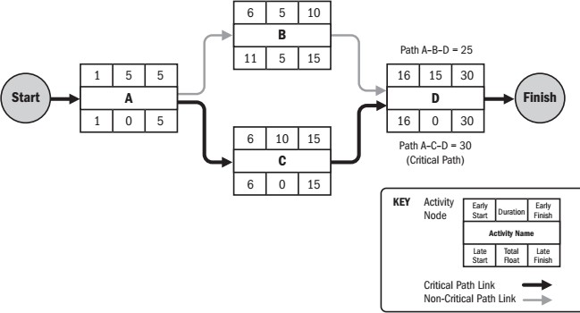
A solved Example
• Schedule network analysis
• Critical path method
• Estimate the minimum project duration and determine the amount of scheduling flexibility on the logical network paths within the schedule model
• Calculates the early start, early finish, late start, and late finish dates for all activities
• The longest path is the critical path
• The shortest possible project duration
• Critical path is normally characterized by zero total float
• Activity on the critical path: critical path activity
• Free float: free time that an activity can be delayed without delaying the early start date of any successor
Figure source: PMBOK® Guide – Fifth Edition, PMI, 2013, pp. 177
4

Slide 5
Critical Path
If you look at any network diagram, you will notice many paths originating from one point and ending at another point.
Every path will have some duration. The path with the longest duration is known as the critical path.
The critical path can be defined in many ways including:
The longest path in the network diagram,
or
The shortest duration in which the project can be completed.

Slide 6
…Critical Path
Q. →Now, are these two definitions similar, or opposite to each other? Ans → Yes both are the same
For example, let’s say you received a project to build three buildings in one location. The first building is the largest building, the second building is a medium-sized building, and the third building is the smallest building.
You develop the network diagram which consists of three paths; each path resembles each building.

Slide 7
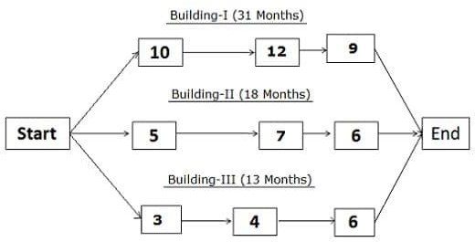
Critical Path
The first path represents the largest building; the second path represents the medium-sized building, and the third path, the smallest building.

Slide 8
…Critical Path
Float
Did you notice that the path for the first building is the longest duration of all three?
It is thirteen months longer than the second path, and 18 months longer than the third path.
This means that you can wait 13 months before working on the second building if you start working on the first building because you can complete the second building in 18 months.

Slide 9
…Critical Path
Float
Likewise, you could wait 18 months to start working on the third building because it will take only 13 months to complete.
This means that even if you start working on the third building after 18 months from the project start date, you can finish it on time.
This waiting period is known as the float or slack.
A→ 31 Months B→18 Months C→ 13 Months
Float for B = Longest Path (A) – Current Path (B)
= 31 - 18
= 13
Float for C = Longest Path (A) – Current Path (C)
=
=
31 – 13
18

Slide 10
…Critical Path
So, which is the critical path in this network diagram of three paths?
Of course, it is the longest path on the network diagram, because you cannot complete your project before constructing the first building. Although you can complete the other two buildings quickly, your project is not considered complete until you complete the first building.
Hence, the critical path is the longest path on the network diagram.

Slide 11
…Critical Path
Now, what is the shortest duration in which you can complete the project?
Sure enough, it is 31 months, because you cannot complete your project before 31 months, and this is the duration of the critical path.
Hence, the critical path is the shortest duration in which you can complete the project.
So, you see that both definitions are the same.

Slide 12
Procedure for Finding the Critical Path in a Network Diagram
The following are the procedures to find the critical path on a network diagram:
Draw the network diagram.
Identify all paths in the network diagram.
Find the duration of each path.
The path with the largest duration is the critical path.

Slide 13
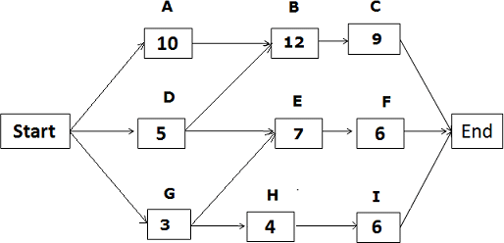
…Procedure for Finding the Critical Path in a Network Diagram

Slide 14
…Procedure for Finding the Critical Path in a Network Diagram
The given network diagram has five paths; the paths and their duration are as follows:
Start -> A -> B -> C-> End, duration: 31 days.
Start -> D -> E -> F -> End, duration: 18 days.
Start -> D -> B -> C -> End, duration: 26 days.
Start -> G -> H -> I -> End, duration: 13 days.
Start -> G -> E -> F -> End, duration: 16 days.
Since the duration of the first path is the longest, it is the critical path. The float on the critical path is zero.

Slide 15
…Procedure for Finding the Critical Path in a Network Diagram
The float for the second path “Start ->D -> E ->F -> End”
=duration of the critical path – duration of the path
= 31 – 18 = 13
Hence, the float for the second path is 13 days.
Using the same process, we can calculate the float for other paths as well.
Float for the third path = 31 – 26 = 5 days. Float for the fourth path = 31 – 13 = 18 days. Float for the fifth path = 31 – 16 = 15 days.

Slide 16
Calculate Early Start (ES), Early Finish (EF), Late Start (LS), and Late Finish (LF)
Calculating Early Start (ES) and Early Finish (EF)
To calculate the Early Start and Early Finish dates, we use forward pass; we will start from the beginning and proceed to the end.
Early Start (ES) for the first activity on any path will be 1, because no activity can be started before the first day
The formula used for calculating Early Start and Early Finish dates. Early Start of the activity = Early Finish of predecessor activity + 1
Early Finish of the activity = Activity duration + Early Start of activity – 1

Slide 17
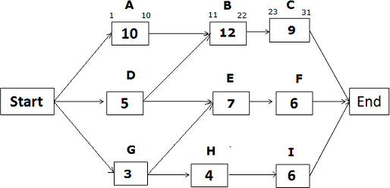
Calculate Early Start (ES), Early Finish (EF), Late Start (LS), and Late Finish (LF)
Early Start of the activity = Early Finish of predecessor activity + 1
Early Finish of the activity = Activity duration + Early Start of activity – 1

Slide 18
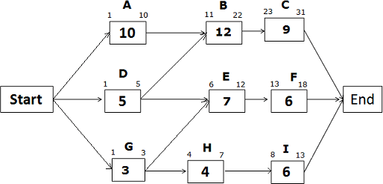
Calculate Early Start (ES), Early Finish (EF), Late Start (LS), and Late Finish (LF)
Early Start of the activity = Early Finish of predecessor activity + 1
Early Finish of the activity = Activity duration + Early Start of activity – 1

Slide 19
Calculate Early Start (ES), Early Finish (EF), Late Start (LS), and Late Finish (LF)
Calculating Late Start (LS) and Late Finish (LF)
Late Finish of the last activity in any path will be the same as the Last Finish of the last activity on the critical path, because you cannot continue any activity once the project is completed.
The formula used for Late Start and Late Finish dates:
Late Start of Activity = Late Finish of activity – activity duration + 1 Late Finish of Activity = Late Start of successor activity – 1
To calculate the Late Start and Late Finish, we use backward pass; i.e. we will start from the last activity and move back towards the first activity.

Slide 20
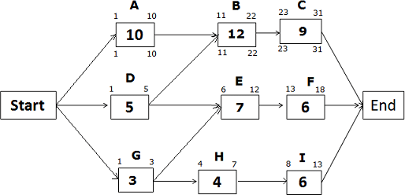
Calculate Early Start (ES), Early Finish (EF), Late Start (LS), and Late Finish (LF)
Late Start and Late Finish Dates for the path Start -> A -> B -> C -> End
On a critical path, Early Start, and Early Finish dates will be the same as Late Start and Late Finish dates

Slide 21
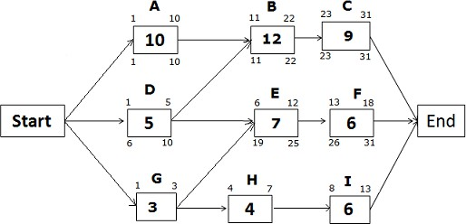
Calculate Early Start (ES), Early Finish (EF), Late Start (LS), and Late Finish (LF)
Late Start and Late Finish Dates for the path Start -> D -> E -> F -> End
Late Finish of activity F = 31 (because you cannot allow any activity to cross the project completion date)
Late Start of activity F = LF of activity F – activity duration + 1
= 31 – 6 +1 = 26

Slide 22
Calculate Early Start (ES), Early Finish (EF), Late Start (LS), and Late Finish (LF)
Late Start and Late Finish Dates for the path Start -> D -> E -> F -> End
Late Finish of activity E = LS of successor activity – 1
= LS of activity F – 1
= 26 – 1 = 25
Late Start of Activity E = LF of activity E – activity duration + 1
= 25 – 7 + 1 = 19
Late Finish of activity D = LS of successor activity – 1

Slide 23
Calculate Early Start (ES), Early Finish (EF), Late Start (LS), and Late Finish (LF)
Late Start and Late Finish Dates for the path Start -> D -> E -> F -> End
If you look at the network diagram, you will notice that activity D has two successor activities, B and E. So, which activity will you select?
You will select the activity with the earlier(least) Late Start date. Here, Late Start of activity B is 11, and Late Start of activity E is 19.
Therefore, you will select activity B which has the earlier Late Start date.
Hence,
Late Finish of activity D = LS of activity B – 1
= 11 – 1 = 10
Late Start of Activity D = LF of activity D – activity duration + 1
= 10 – 5 + 1 = 6

Slide 24
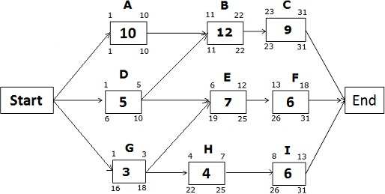

Slide 25
Calculate the Free and Total Float
Total Float
Many of us are aware of Total float, which is commonly referred to as a float.
Total float is the amount of time an activity can be delayed without delaying the project completion date. On a critical path, the total float is zero.
Total float is often known as the slack.
You can calculate the total float by subtracting the Early Start date of activity from its Late Start date (Late Start date – Early Start date), or Early Finish date from its Late Finish date (Late Finish date – Early Finish date).

Slide 26
Calculate the Free and Total Float
Free Float
Now, we come to free float. This is going to be a bit different and might be new to you.
Free float is the amount of time an activity can be delayed without delaying the Early Start of its successor activity.
You can calculate the free float by subtracting the Early Finish date of the activity from the Early Start date of the next activity (ES of next Activity – EF of current Activity).
Please note that if two activities are converging to a single activity, only one of these two activities may have a free float.

Slide 27
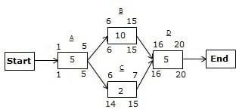
Calculate the Free and Total Float

Slide 28
Calculate the Free and Total Float
There are two paths in the above network diagram:
The first path is A->B->D with 20 days’ duration, and
The second path is A->C->D with 12 days’ duration.
The path A->B->D is the critical path because it has the most extended duration.

Slide 29
Calculate the Free and Total Float
The first method of finding the Total Float
Total float = duration of the critical path – duration of the non- critical path
= (duration of the path A->B->D) – (duration of the path A->C->D)
= 20 – 12
= 8
Hence, the total float is eight days.

Slide 30
Calculate the Free and Total Float
The second method of finding the Total Float
On the path A->C->D, Activity A and D lie on the critical path; therefore, they will not have a total float. Only Activity C can have a total float.
As stated earlier, we can calculate the total float by using either finish dates or start dates. Here, I will show you both ways to find it.
First, we will go with the Late Finish and Early Finish dates: Total float for Activity C = (LF of Activity C – EF of Activity C)
= 15 – 7 = 8
Now, the second formula:
Total float for Activity C = (LS of Activity C – ES of Activity C)
= 14 – 6 = 8
As you can see, both durations are the same, which means both formulas will provide you with the same result.

Slide 31
Calculate the Free and Total Float
Calculating the Free Float
From the figure, you can see that only Activity C can have a free float because other activities are lying on the critical path.
Let’s find it.
Free float of Activity C = ES of next Activity – EF of Activity C – 1
= 16 – 7 – 1
= 8
Hence, the free float for activity C is eight days.
Now it is time to move on to a more complex example.

Slide 32
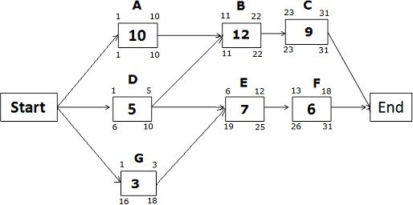
Calculate the Free and Total Float, Another Example
For the below-given network diagram, identify which activities can have a free float and calculate the free and total float for those activities, considering duration in days.

Slide 33
Calculate the Free and Total Float, Another Example
We know that,
Free float = ES of next Activity – EF of current Activity – 1
In the above diagram, Activity G can have the free float because Activity D and G are converging on one common activity.
Activity D will not have a free float because its successor Activity E is starting on the next day of completing Activity D.

Slide 34
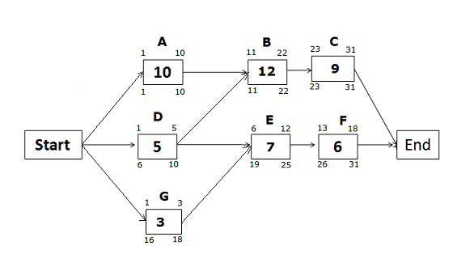
Calculate the Free and Total Float, Another Example
Free Float for Activity G
We know the formula for free float:
Free float of Activity G = Early Start of Activity E – Early Finish of Activity G – 1
• = 6 – 3 – 1
• = 2
Total Float for Activity G
Total float for Activity G = Late Finish of Activity G – Early Finish of Activity G
• = 18 – 3
• = 15
You can see here that the free float for Activity G is two days, and the total float is 15 days. Both are different.

Slide 35
Benefits of the Critical Path Method
The following are a few benefits of the critical path method:
It shows the graphical view of the project.
It discovers and makes dependencies visible.
It helps in project planning, scheduling, and controlling.
It helps in contingency planning.
It shows the critical path, and identifies critical activities requiring special attention.
It helps you assign the float to activities and flexibility to float activities.
It shows you where you need to take action to bring project back on track.
Although the critical path is very useful tool in project planning, it also has some limitations and drawbacks.

Slide 36
Limitations and drawbacks of the Critical Path Method
Because the critical path method is an optimal planning tool, it always assumes that all resources are available for the project at all times.
It does not consider resource dependencies.
There are chances of misusing float or slack.
Less attention on non-critical activities, though sometimes they may also become critical activities.
Projects based on the critical path often fail to be completed within the approved time duration.
To overcome these shortcomings of the critical path, the critical chain method was developed. In the critical chain method resource constraints are also taken into consideration while developing the network diagram.

